Slide 1
A new generation of European Science Parks driving industrial development
- the case of Gothenburg and Chalmers University of Technology
Mats.Lundqvist@chalmers.se
Director and co-founder
Chalmers School of Entrepreneurshpi

Slide 2
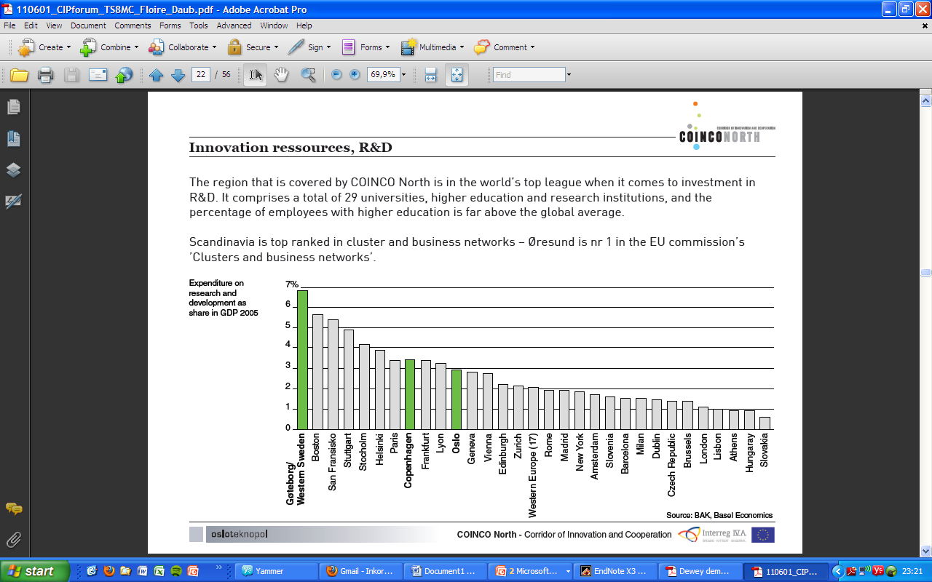
Gothenburg – situated in the middle of a European ”mega-region”
8 million out of Scandinavia´s 19 million people live in the corridor between Oslo and Copenhagen
  29 universities and university colleges
  260 000 university students
  14 000 researchers
  22 science parks/incubators
  44 000 new businesses annually
Very high research expenditures
  One of the world’s most innovative regions
Oslo
Gothenburg
Öresund
“Mega-regions are large-scale economic units of multiple large cities and their surrounding suburbs”
Richard Florida, ”The Rise of the Creative Class”

Slide 3

Founded in 1829
In 1836 it became a state institution
In 1994 Chalmers became a private foundation again – the only private university of technology in Sweden
Engineering, science, management, architecture and life science in 17 departments
11,000 students, 1000 PhD candidates and 1450 faculty
Recent developments:
2007 Chalmers with U Gothenburg became on of five keyactor projects (professionalizing utilization and collaboration)
2008 Chalmers became responsible to start “Innovation Office West” (one of eight offices in Sweden)
2009 The application “Gothenburg Schools of Entrepreneurship” was ranked number one by government

Slide 4
Main points
First generation Science Parks
  Focus on real estate and proximity to universities to enable collaboration and exchange
Second generation Science Parks - Incubators
  Focus on offering advice, seed capital, office etc to new ventures
Third generation Science Parks - realizing much bigger potential
  Technology transfer, Venture Creation and Acceleration integrated with entrepreneurship education
  Focus on recruiting and developing entrepreneurial competence
  Playing active founding and ownership role

Slide 6

5.000 persons employed at Lindholmen
100 companies at the Science Park area
3.000 students, teachers and researchers at Campus Lindholmen
The main building - the Hub
Chalmers Innovation business incubator
7 high schools with 4.000 students

Slide 7
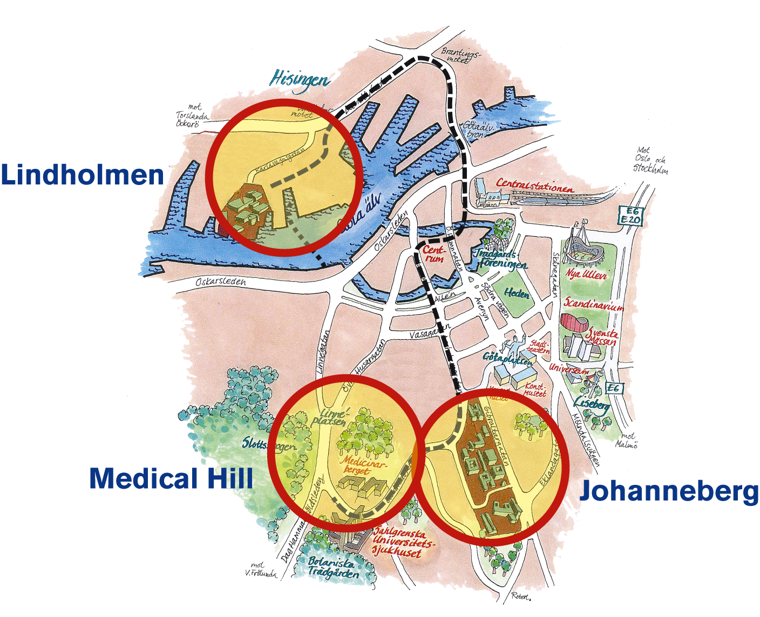

Slide 9
Why Chalmers School of Entrepreneurship was founded 1997
Value
Business
?
Research
Time
Notes:
9

Slide 10
Sweden’s fastest growing young companies today (companies less than 10 years old, with international potential)
These were started at Chalmers School of Entrepreneurship
Source: www.emerging101.com

Slide 11
Chalmers School of Entrepreneurship
- a two year international MSc program
Year 1
Year 2

Slide 12
Behind a venture launch is a ”three stage rocket” of entrepreneurial competence development
1
Simulation
2
Idea evaluation
Year 1
Year 2
3
Venture creation
Venture
launch?
80%
survival rate!

Slide 13
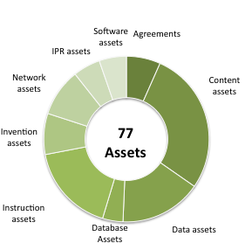
Example: students identified 77 assets within an informal 40 person biomarker collaboration
Type of Asset | Description
Invention | Knowledge of a potential antibody coating of the silicon collection plate surface to collect specific X
Invention | Knowledge on how to modify X to increase the collection of smaller X by increasing X
Invention | Knowledge on how to redesign X in a way that smaller X can be captured by lowering X
Invention | knowledge on how to design the prototype to reduce start-up time using other materials
Data | Results from the X study
Data | Composition data from use of TX
Data | Results from X study
Data | Analyzed data from X and X
Data | Results from X study
Database | Database containing Analyzed and sorted data
Database | Database containing Analyzed and sorted data from X study
Database | Database containing results from prior X study
Instruction | Documentation on how to set-up experimentaion with X
Instruction | Documentation on how to set-up experimentation for identifying X in samples

Slide 14
Students assessed uniqueness in relation to other research groups and companies
4,18
2,3,11
9,19
17
6,14
12
15
1,7,10,13
8,16
5.

Slide 15
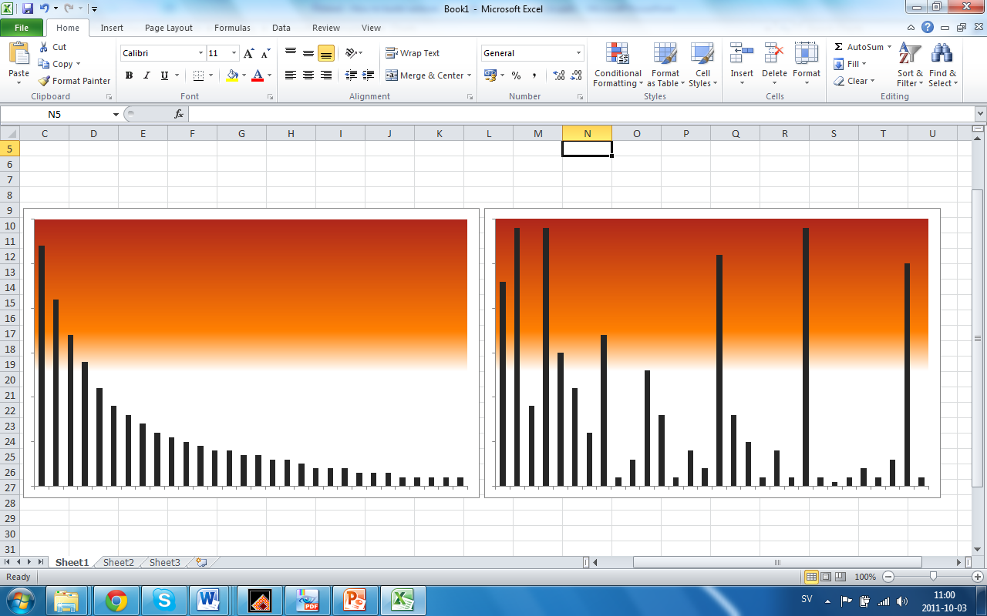
University technology transfer today
- realizing only the top of the iceberg?
Initially perceived potential
High potential
Low potential
Number of inventions / ideas
Inventions licensed to industry by TTO
Inventions discarded / archived

Slide 16
Education and technology transfer – reaching out for the high-hanging fruits
Terminal potential
High potential
Low potential
Number of inventions / ideas
Inventions licensed to industry by TTO
Inventions harvested by entrepreneurial students

Slide 17
A generic production system
New products, units and corporate spin-outs
Technology Transfer Office
IP
Corporations
Real-life based Entrepreneurship Education Program
IP
Challenges
Private innovators
IP and business ideas
New products and university spin-outs
IP and business ideas
Students
Entrepreneurial capacity
Business ideas

Slide 18
E-schools vs B-schools
Scalable
Startup
Tran-sition
Large
Company
Our School of
Entrepreneurship!
Entrepreneurial management
Creativity and innovation
Technology entrepreneurship
Patent law for engineers
Global entrepreneurial marketing
Entrepreneurial finance
Managerial finance and accounting
Managing groups and teams
Financial accounting
Operations
Modeling for optimization
Global value chain strategies
From Steve Blank, UC Berkeley lecture on http://www.justin.tv/startuplessonslearned/b/262670582

Slide 19


Entrepreneurship education
- Appears in many forms
learning
ABOUT
entrepreneurship
learning
FOR/IN
entrepreneurship
Thoughts / ”Cognition”
Actions / ”Conation”

Slide 20

Our view on entrepreneurship education
Feelings / ”Affection”
learning
THROUGH
entrepreneurship
learning
ABOUT
entrepreneurship
learning
FOR/IN
entrepreneurship
Thoughts / ”Cognition”
Actions / ”Conation”

Slide 21
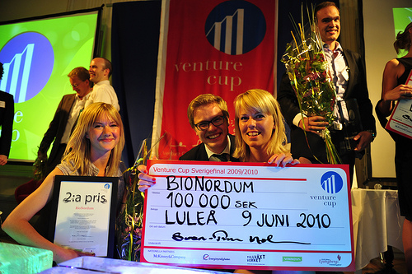
Our entrepreneurs

Slide 22
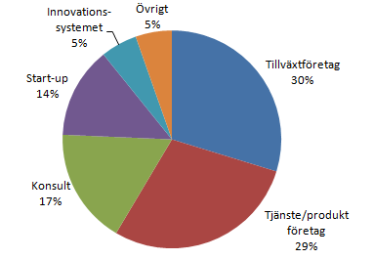
Chalmers School of Entrepreneurship alumni
February 2009 data, Population 220.
50% working in start-ups, growth companies or in the innovation system
80% live in Gothenburg or Stockholm
  60% live in the Gothenburg region
  20% in the Stockholm region
  15% in rest-Sweden and Europe
  5% live outside Europe
Innovation
system
Others
Others
Growth company
Start-up
Consultant
Service/Product
company

Slide 23




























Some results from a decade of venture creation at Chalmers

Slide 24
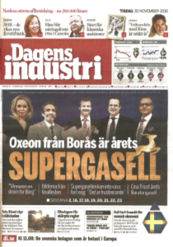
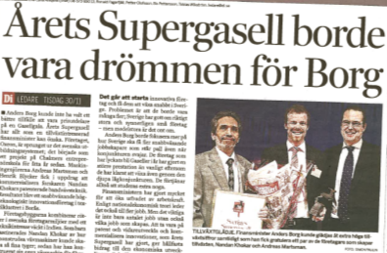
Some results from a decade of venture creation at Chalmers
”This year’s Super Gazelle has everything that a growth interested finance minister could wish for. The company has sprung out of the educational system; it started as a project at Chalmers School of Entrepreneurship eight years ago.”
Editorial of Dagens Industri, November 2010

Slide 25
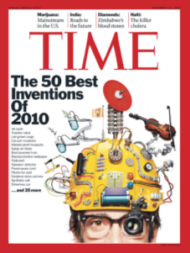
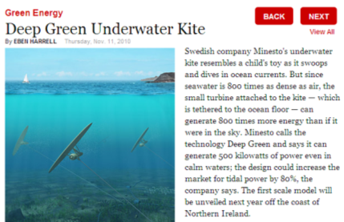
Some results from a decade of venture creation at Chalmers

Slide 26
Conclusions
A new generation of science park – the combined technology transfer – accelerator – entrepreneurship education:
  Realizes the potential of nascent entrepreneurs
  Realizes the potential of innovative research
  Builds new ventures – 80% survival rate
  Builds entrepreneurial ecosystem
  Europe can take the lead regarding a ”visible hand” approach to innovation and entrepreneurship

